Slide 1
Cholera in Haiti.
One of the serious aftermaths of the Haiti earthquake was the disease known as Cholera.

Slide 2
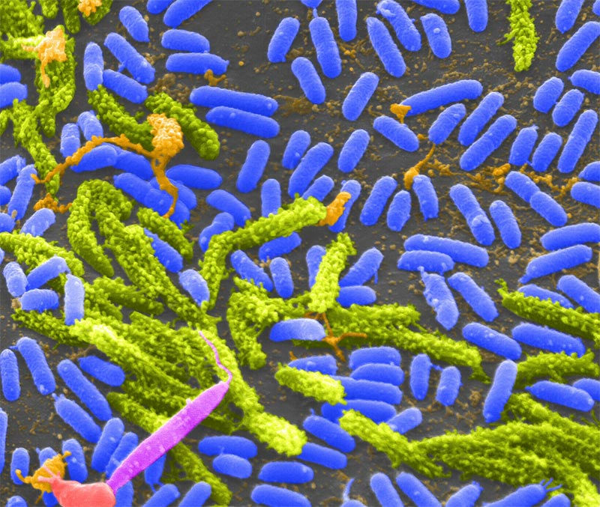
What is Cholera?
Cholera is an acute diarrheal disease caused by infection, which can kill even a healthy adult in a matter of hours.

Slide 3
The symptoms of Cholera in Haiti 2010.
Vomiting
Severe watery diarrhoea
Extreme dehydration
infected people can die of profound dehydration
Kidney failure

Slide 4
The Death rate in Haiti 2010 based on Cholera.

Slide 5
Death tolls due to Cholera in Haiti.
In Haiti the health ministry announced that the death toll had risen within 24hrs from 135 to 724
Aid agencies began to fear that Cholera would spread to the tented camps, ‘we greatly fear a flare-up in the capital which would be serious given the conditions in the camps’ .

Slide 6
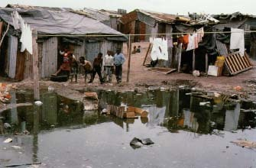
The causes of Cholera
Transmission is primarily by the fecal contamination of food and water caused by poor sanitation. This bacterium can however, live naturally in any environment, which is very dangerous.

Slide 7
Prevention of cholera.
Although cholera may be life-threatening, prevention of the disease is normally straightforward if proper sanitation practices are followed.
In developed countries, due to nearly universal advanced water treatment and sanitation practices, cholera is no longer a major health threat.

Slide 8
Treatment
In Haiti 2010 there was no treatment available to the people of Haiti.
Clean water ,food and good sanitation levels was the way forward for a patient in Haiti. Clean water and good sanitation levels was very hard to get after the earthquake in Haiti 2010.

Slide 9
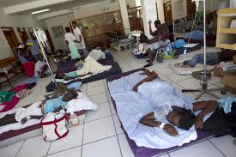
People in Haiti suffering from Cholera :

Slide 10
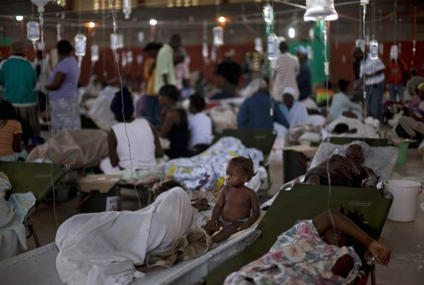
Crowded areas in Haiti for people with Cholera:

Slide 11
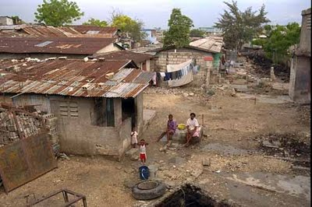

Slide 12
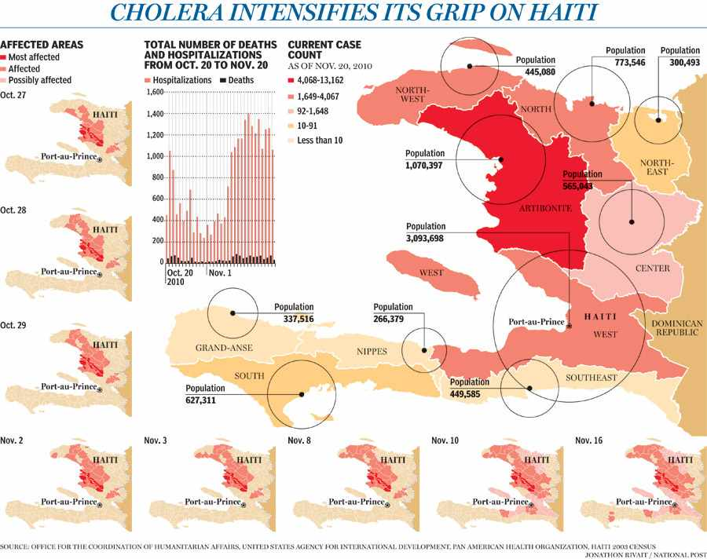

Slide 13
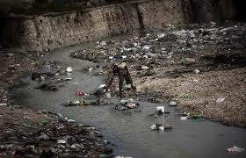
Dirty water in Cholera which is an effect that caused Cholera in Haiti.

Slide 14
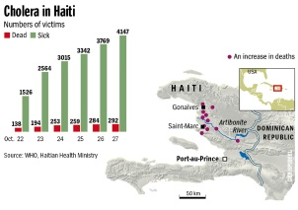

Slide 15
Cholera one of the main aftermaths
As we can see Cholera was a very dangerous and serious aftermath of the Haiti earthquake in 2010.
It killed massive numbers of people and caused horrible scenes within Haiti.

