Slide 1
Haiti : The Earthquake
Contents:
Haiti On The World Map
The Effects Of The Earthquake
How It Happened
Transform Boundaries
Aftermath
Damage Caused
American Red Cross Response
Cholera
Trouble At The Airport

Slide 2
Haiti On The Map
The Republic Of Haiti is a Caribbean country. It occupies the western, smaller portion of the island of Hispaniola, which it shares with the Dominican Republic. The island of Hispaniola lies between the Atlantic Ocean and Caribbean Sea

Slide 3
The Effects Of The Earthquake.
Haiti Before the Earthquake
More than 70% of people in Haiti were living on less than $US2 per day
86% of people in Port au Prince were living in slum conditions - mostly tightly-packed, poorly-built, concrete buildings.
80% of education in Haiti was provided in often poor-quality private schools, the state system generally provided better education but provided far too few places
Half of people in Port-au-Prince had no access to latrines and only one-third has access to tap water

Slide 4
The Effects Of The Earthquake.
3,500,000 people were affected by the quake
300,000+ people were injured
Over 188,383 houses were badly damaged and 105,000 were destroyed by the earthquake (293,383 in total), 1.5m people became homeless
After the quake there were 19 million cubic metres of rubble and debris in Port au Prince – enough to fill a line of shipping containers stretching end to end from London to Beirut.

Slide 5
How It Happened.
The Haiti Earthquake happened on January 12, 2010 along the Enriquillo-Plantain Garden Fault.
The Enriquillo-Plantain Garden Fault is the fault the splits the North America and Caribbean Plates.
It happened because the Caribbean Plate was sliding beside the NA plate. This is called a transform boundary.
It struck 10 miles from the capital Port-Au-Prince.
The Haiti earthquake measured around 7.0 on the Richter Scale

Slide 6
Transform Boundaries.
Transform boundaries occur when two plates are sliding along each other in opposing directions. Due to friction when the plates buckle and shift, they often cause earthquakes.

Slide 7
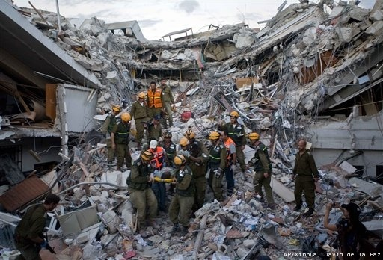
Aftermath
Masses of water and food has been sent to relieve Haiti.
Over 7500 U.S troops were sent over to help with the order and sanitation of Haiti citizens.
Many countries also sent over money and supplies as a source of aid

Slide 8
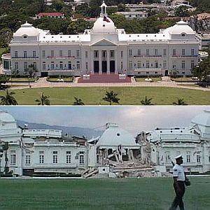
Damage Caused
The damage caused by the earthquake in Haiti in January 2010 has been estimated at about $14 billion.

Slide 9
Damage Caused
Over three million people were affected and up to two million left homeless.
The estimated death toll, a month after the event, was given at around 230,000.
In the city of Léogâne alone, it was estimated that 90% of the buildings were damaged.
Around half of the 16,500 or so schools in Haiti were damaged, along with the three main universities in Port-au-Prince.

Slide 10
American Red Cross Response
Recovery activities have included building homes, giving people opportunities to earn money, providing access to clean water and sanitation systems, supporting the delivery of health care, and teaching communities how to prevent the spread of diseases and be better prepared for future disasters.

Slide 11
Cholera
Cholera is a bacterial disease that can cause diarrhea and dehydration. Cholera is most often spread through the ingestion of contaminated food or drinking water. Water may be contaminated by the feces of an infected person or by untreated sewage. Food is often contaminated by water containing cholera bacteria or by being handled by a person ill with cholera.

Slide 12
Current Cholera Situation In Haiti
An outbreak of cholera has been ongoing in Haiti since October 2010. According to the Ministere de la Sante Publique et de la Population (MSPP), as of July 22, 2012, 581,952 cases and 7,455 deaths have been reported since the cholera epidemic began in Haiti. Cases have been officially reported in all 10 departments of Haiti. Since spring, cases have increased significantly in the Centre and Nord departments and in Port-au-Prince, the country’s capital In Port-au-Prince, 158,575 cases have been reported since the beginning of the outbreak.

Slide 13
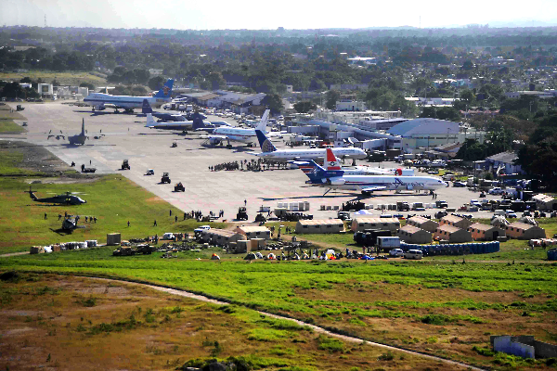
Trouble At The Airport
Planes with food, medicine and emergency workers from nearly a dozen countries are struggling to land, since cargo can't be offloaded and cleared fast enough.

