Slide 1
Crime in Haiti
By Sarah Marnane and Lydia Morgan

Slide 2
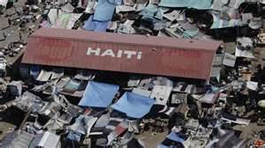
Did YOU know...?!
The Earthquake reached 7.0 on the Richter Scale on the 12/1/2010
At least 52 aftershocks occurred.
3 million people were affected.
316,000 people died. 300,000 were injured. 1 million were left homeless.

Slide 3
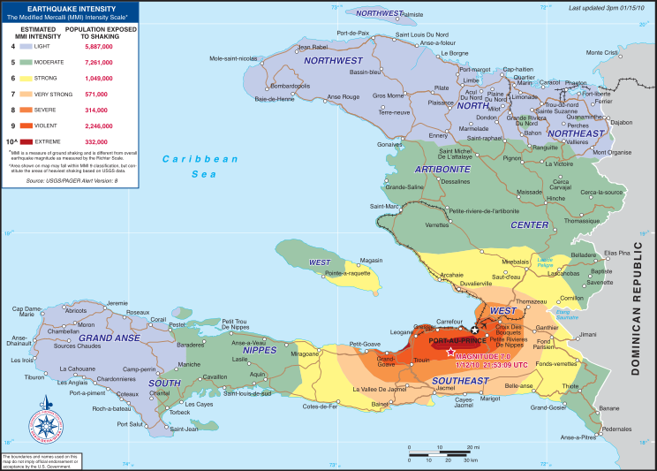

Slide 4
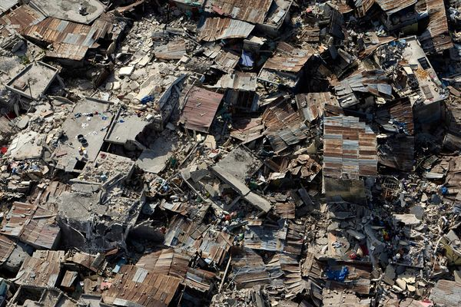
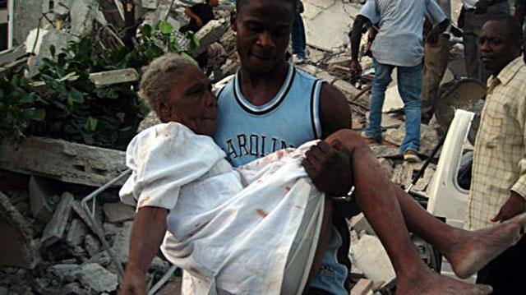
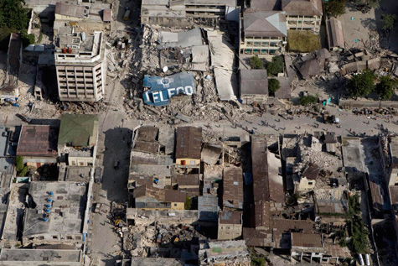

Slide 5
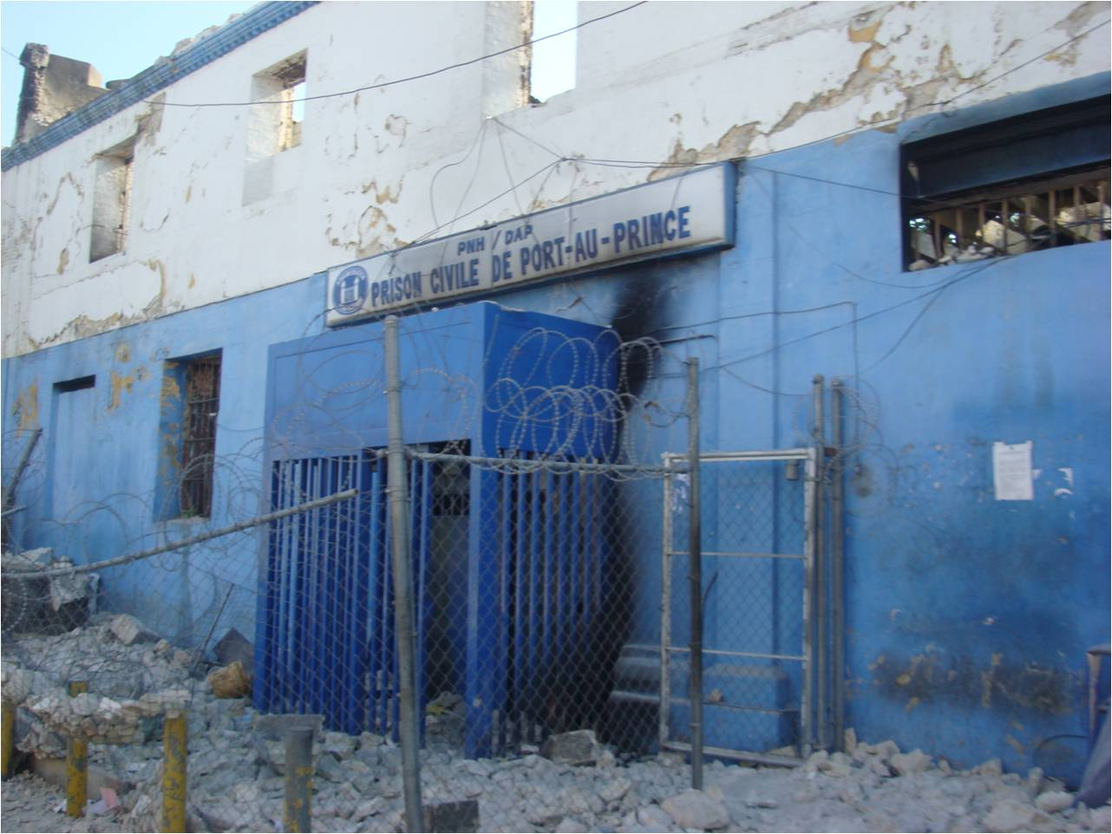
Haiti Prison
More than 5000 prisoners escaped in the whole country.
The national Penitentiary prison built for 800 held 4,125 at the time of the earthquake and they all escaped.
In Haiti’s Les Cayes prison, 14 prison guards and police men were charged with murder of escaped prisoners.
Many criminals who escaped were American and deported to Haiti Jail as the American prisons were full
9 out of 10 prisoners in the jail had never been convicted of any crime.

Slide 6
Haitian Prison Conditions
The jails were so overcrowded that the junior prisoners had to attempt sleeping standing up in temperatures reaching up to 105°
The junior prisoners legs started to swell up after a few days and became extremely sore.
The food is filled with baking powder to bulk it up and this goes off almost immediately.
Prisoners who protest against these conditions are punished by being sent to a cage under a concrete staircase. It is too low to stand up and not long enough to lie down. 15 prisoners at a time are forced to stay in these conditions for up to a month with no toilet facilities. EW!

Slide 7
Wilberle Vereus
Wilberle is an American citizen deported to the Petionville jail above Port-au-Prince. He is 22 years old . When he was 2 he fled Haiti on a boat with his family, but was sent back even though he became a legal resident.
He committed no crime in Haiti.
The U.S sent back 250 Haitians, knowing that half would be sent to jail for no reason.

Slide 8
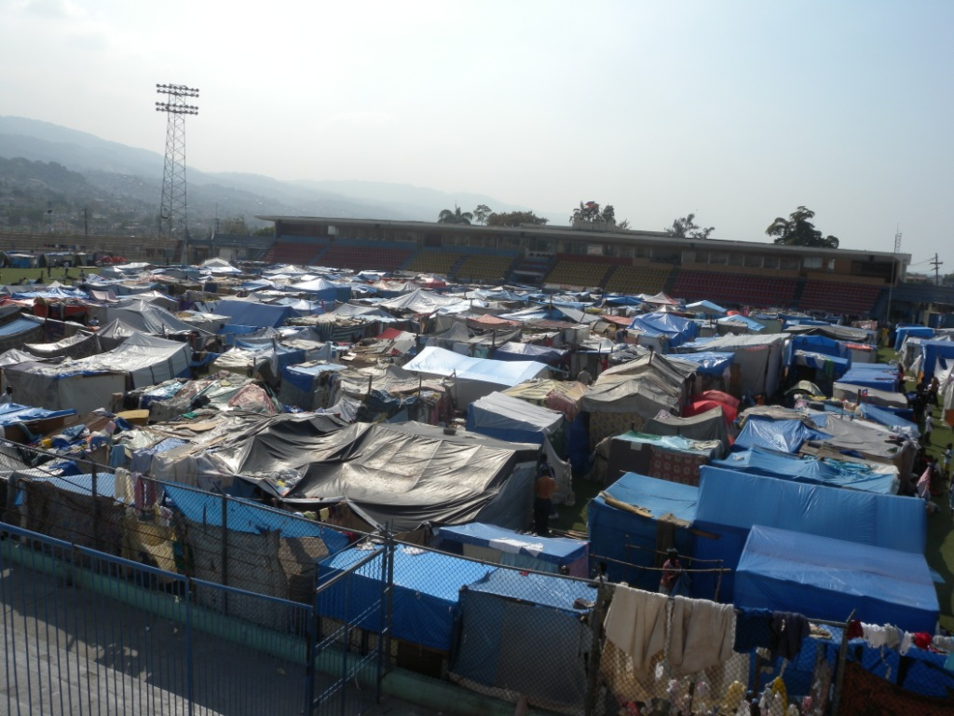
IDP Camps (Internally Displaced Person)

Slide 9
IDP camps were set up to house people who’s homes were destroyed in the earthquake
1.5 million people have been forced to live in these camps
They have very bad living conditions and some camps don’t even have running water!

Slide 10
They are mostly ran by gang members who have escaped from jail.
These members steal from, hurt, and terrorise the people living in the camps and overcharge them for staying in these poorly run camps.

Slide 11
Sexual Abuse in the camps
3 times more women have become pregnant in the camps than before the earthquake.
14% of respondents who took a survey reported that one or more members of their household had been victimized by rape or unwanted touching since the 2010 earthquake.
9% reported that they or a member of their household had experienced rape or forced sex since the earthquake; and 8% reporting that they had experienced some other form of unwanted touching or sexual harassment.

Slide 12
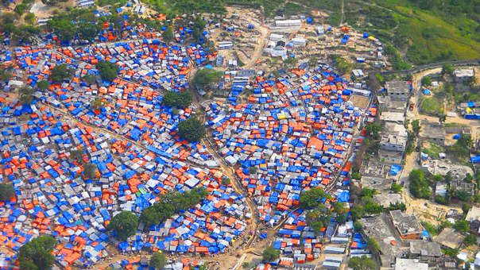
More than 250 cases of rape in several camps were reported in the first 150 days after the earthquake.
A majority of these rape cases were gang rapes.
43% were against woman and girls under the age of 20.
Although, Victims ranged from 1 to 84 years old.

Slide 13
SWAT Team capturing escaped criminals
SWAT teams tried to track down escaped criminals and bring them back into custody.
5100 prisoners escaped and so far about 36 of them have been captured.

Slide 14
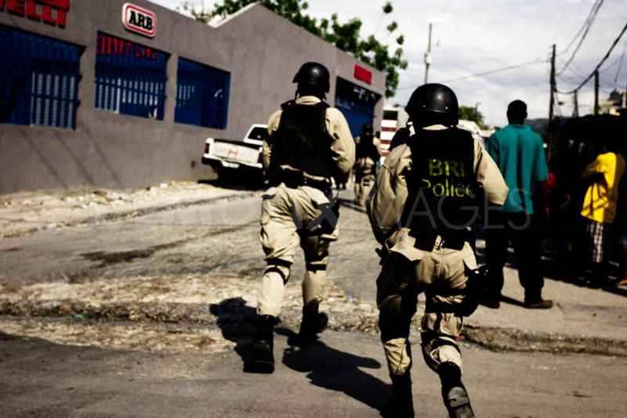

Slide 15
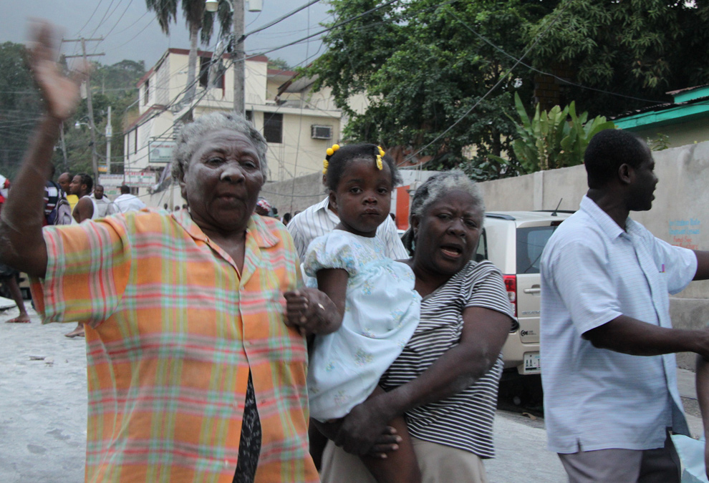
Thanks for watching!

