Slide 1
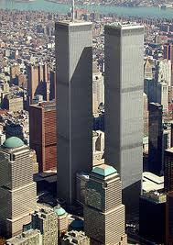
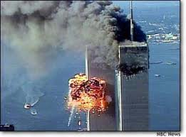
World Trade Centre

Slide 2
The Attack
The September 11th attacks also referred to the 9/11 were a series of four coordinated suicide attacks upon the United States in New York City. The hijackers intentionally flew two planes into the North and South towers of the World Trade Centre. Both towers collapsed in less than two hours. Nearly 3,000 people died in the attacks including all 227 civilians and 19 hijackers aboard the four planes.

Slide 3
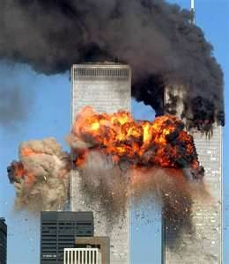
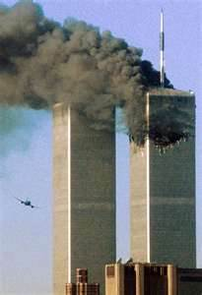
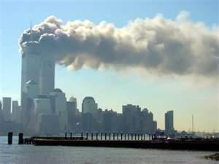
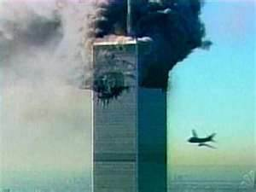

Slide 4
Suspicion
Suspicion Quickly fell on Al-Qaeda in 2004 the groups leader, Osama Bin Laden who initially denied involvement claimed responsibility for the attacks.

Slide 5
Osama Bin Laden
Osama Bin Laden who arranged the attacks denied it at first but then later admitted to it.
Shortly before the U.S presidential election in 2004 in a taped statement, Bin Laden publicly acknowledged al- Qaedas involvement in the attacks. He said the attacks were carried out because `` We are free and want to regain freedom for our nation``.

Slide 6
http://www.youtube.com/watch?v=wNNTcHq5Tzk

Slide 7
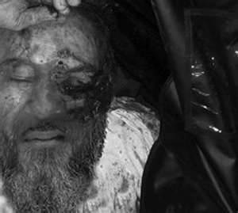
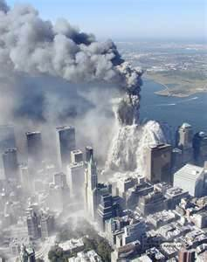
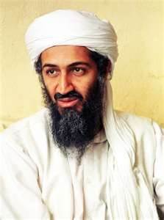

Slide 8
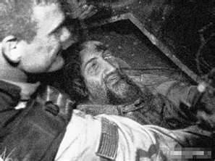
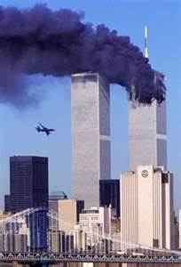

Slide 9
facts
On September 11, 2001, 19 al-Qaeda terrorists coordinated suicide attacks. They all had the intent of dying in the process of killing others.
All 19 coordinators died, crashing two planes into the Twin Towers of the World Trade Center in New York City, another plane into Pentagon in Virginia and the fourth and final plane into a field in Pennsylvania. They killed 2,973 victims in the process.
These planes were far from empty. The al-Qaeda terrorists hijacked commercial planes, run by American Airlines and United Airlines. 246 people occupied these four planes, 246 people died on these four planes. The fourth plane was crashed as the result of onboard passengers and flight crew battling with the terrorists in attempt to take

Slide 10
Movies about 911
25th Hour
The Siege
United 93
World Trade Center

Slide 11
http://youtu.be/BX go to 35 secounds ☺

