Slide 2
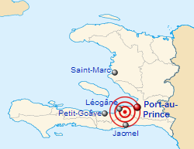
The 2010 Haiti earthquake was a catastrophic magnitude 7.0 earthquake, with an epicenter near the town of Léogâne, approximately 25 km (16 miles) west of Port-au-Prince, Haiti's capital. The earthquake occurred at 16:53 local time on Tuesday, 12 January 2010.

Slide 3
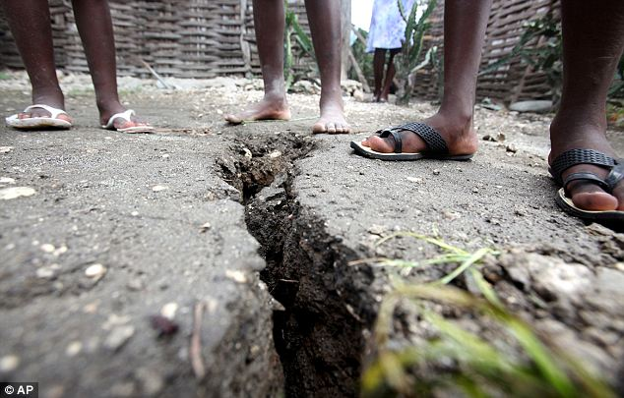

Slide 4
Addressing Corruption In Haiti: An Overview.
In the aftermath of the disastrous earthquake of January 12, 2010, Haiti will receive unprecedented aid for reconstruction and for its promising economic strategy.
But given the country’s legacy of corruption, massive aid could simply result in another massive Haitian failure. Success hinges on facing corruption squarely and developing a hard‐headed, politically sensitive anti‐corruption strategy.
How this could be done, given Haiti’s realities and lessons from fighting corruption around the world, is the subject of this presentation.

Slide 5
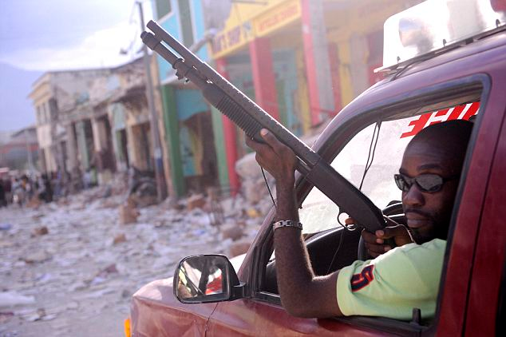

Slide 6
Corruption has Worsened
An analysis of the report by the Chairman of the Port-au-Prince Bar Association, Stanley Gaston, found that a 2012 analysis of corruption in Haiti would be even worse, taking into account recent events.
”For the year 2012, the report is going to be even more grave because if you look at all the scandals that we are faced with today.”
”If you look at the comportment of the parliamentarians. You get the impression that in the Haitian Parliament things are done by what you are offering. This means to say, in this country everything is money. There isn’t value in any other thing.”
”In the executive government there is the same perception, on the level of the judiciary it is the same perception, this makes more than 10 years that Haiti has been given the last place in the international reports.”

Slide 8
Corruption.
Political corruption is a common problem in Haiti. The country has consistently ranked as one of the most corrupt nations according to the Corruption Perceptions Index, a measure of perceived political corruption. In 2006, Haiti was ranked as the most corrupt nation out of the 163 that were surveyed for the Index. The International Red Cross reported that Haiti was 155th out of 159 countries in a similar survey of corrupt countries.

Slide 9
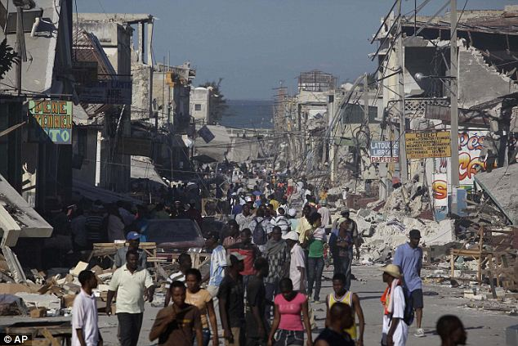

Slide 10
Quotes ^.^
The first thing that strikes you is the smell: a sweet, sickly stench that sticks to your skin. It is worst in the morning, since women are terrified of risking a nocturnal trip to the handful of lavatories serving the thousands of people in the camp because of an epidemic of rape. Even the youngest girls are in danger.
------------------------------------------------------------------------------------
"The government has had its head in the clouds while the country is stuck on the ground,“

Slide 11
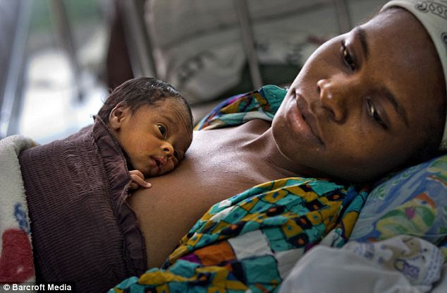

Slide 12
Ricardo lifts the faded sheet that serves as his front door. His three-week-old baby lies asleep on the single bed that fills the family’s home, while his two-year old son screams at the back entrance. The heat under the plastic roof is so intense his wife Roseline, 27, drips with sweat as she describes living in such hell. She looks exhausted. If she is lucky, she says, she has one meal a day, but often goes two days without food, putting salt in water to keep her going. Since giving birth she has passed out a number of times and does not produce enough breast milk to feed her new son. She shows me a small can of condensed milk she gives him; she cannot afford the baby formula he needs. So had they seen any of the huge sums of aid donated to alleviate such hardship? They shake their heads — just one hygiene kit from the local Red Cross. ‘I have heard about this aid but never seen it,’ says Roseline. ‘I don’t think people like us stood a chance of getting

Slide 13
Fernande Bien Amie, a mother of two, said they felt betrayed by aid groups reneging on promises and by their government’s failure to monitor them. ‘These NGOs just do whatever they want, then leave whenever they want,’ she said.

Slide 14
After the quake, the world rushed to help again. But many official pledges of assistance turned out to be little more than lies, with half the promised funds never turning up and huge slices of the rest diverted back to donors. The largest single recipient of U.S. earthquake aid, for example, was the U.S. government.

Slide 15
One car dealer sold more than 250 Toyota Land Cruisers a month at £40,000 each. ‘You see traffic jams at Friday lunchtime of all the white NGO and UN four-wheel drives heading off early to the beaches for the weekend,’ said one Irish aid worker. ‘It makes me sick.’

Slide 16
The Haitian Presidential Palace
Before
After

Slide 17
The Cathedral in Port-au-Prince Before
Before
After

Slide 18
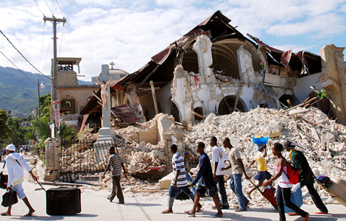
The Remains…

Slide 19
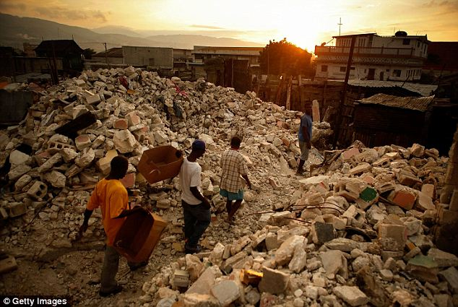
Rubble: Earthquake damage in downtown Port Au Prince, Haiti, in January 2010 Haiti is destroyed to this day.. They’re trying to rebuild their home with what little resources they have left..

Slide 20
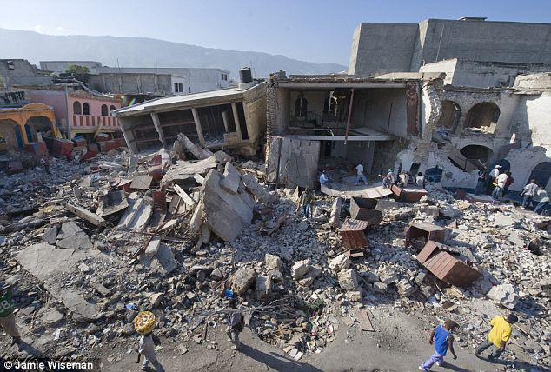

Slide 22
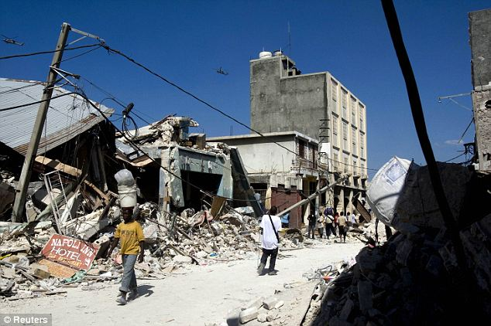

Slide 23
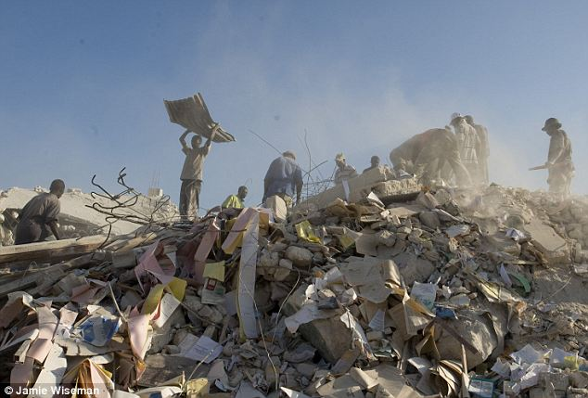

Slide 24
By Sabrina dempsey ^-^’
The end. :3

