Slide 1
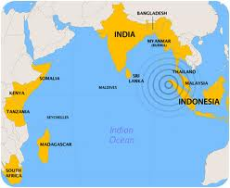
Boxing Day Earthquake and Tsunami

Slide 2
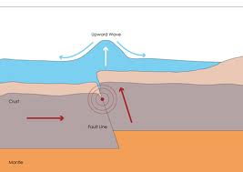
How does a Tsunami occur?
Tsunamis occur when an earthquake happens underwater.
Tsunamis can also happen due to landslides underwater.
The wave produced by the earthquake can be huge and cause large amounts of damage.

Slide 3
Facts about the Earthquake
The Indonesian-Australian plate sub ducted underneath the Sunda Plate, causing the underwater Earthquake.
The seabed rose by up to 7m during the earthquake, displacing massive volumes of water.
The earthquake reached a magnitude of approximately 9.0.

Slide 4
Boxing Day Tsunami
On Sunday 26th December 2004 at 00:58:53, the Boxing Day tsunami occurred, causing widespread destruction and a high death toll.
275000 people died and 14 countries were countries were effected mainly Indonesia, Thailand, India and Sri Lanka.
Over 60000 people in Acen lost their jobs.

Slide 5
Facts about the tsunami
The tsunami reached heights of up to 20m and speeds of up to 500km/h.
It was the 4th largest earthquake ever recorded.
The tsunami reached speeds of 500km/h and heights of up to 20m!!!

Slide 6
The Tsunami!
http://www.youtube.com/watch?v=RDOuwMj7Xzo
A clip of the Boxing Day Tsunami

Slide 7
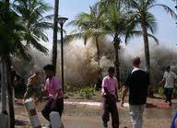
Pictures of the Tsunami

Slide 8
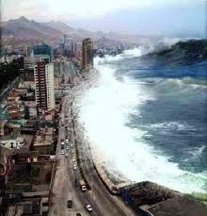
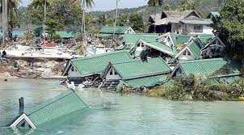

Slide 9
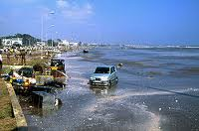

Slide 10
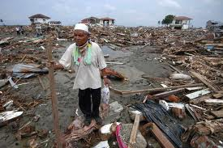
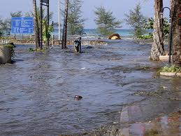

Slide 11
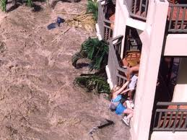
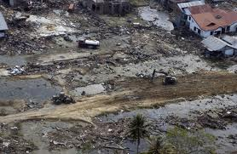

Slide 12
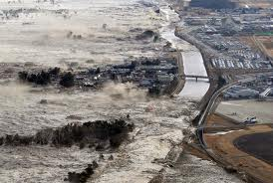

Slide 13
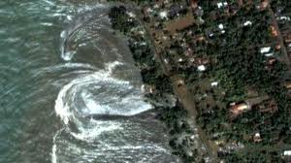

Slide 14
Boxing Day Tsunami vs. The Japan Tsunami
Boxing Day Tsunami
Japan Tsunami
Magnitude of 9.0.
7m upthrust.
275000 people died.
Magnitude of 9.0.
5-8m of an upthrust.
15782 people died.

