Slide 1
Pompeii VOLCANO
Ryan McCarthy

Slide 2
Pompeii Volcano
By the 1st century AD, Pompeii was one of a number of towns located near the base of the volcano, Mount Vesuvius. The area had a substantial population which grew prosperous from the region's renowned agricultural fertility. Many of Pompeii's neighboring communities, most famously Herculaneum, also suffered damage or destruction during the 79 eruption. The eruption occurred on August 24, just one day after Vulcanalia, the festival of the Roman god of fire, including that from volcanoes

Slide 3
Mt Vesuvius
Mount Vesuvius is best known for its eruption in AD 79 that led to the burying and destruction of the Roman cities of Pompeii and Herculaneum. They were never rebuilt, although surviving townspeople and probably looters did undertake extensive salvage work after the destructions. The towns' locations were eventually forgotten until their accidental rediscovery in the 18th century.
Vesuvius has a long historic and literary tradition. It was considered a divinity of the Genius type at the time of the eruption of 79 AD: it appears under the inscribed name Vesuvius as a serpent in the decorative frescos of many lararia, or household shrines, surviving from Pompeii.

Slide 4
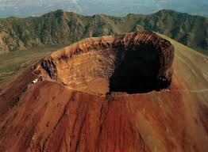
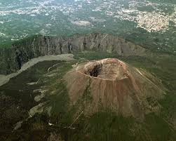
Vesuvius

Slide 5
Eruption
The famous eruption in 79 AD was preceded by numerous others in prehistory, including at least three significantly larger ones, the best known being the Avellino eruption around 1800 BC which engulfed several Bronze Age settlements. Since 79 AD, the volcano has also erupted repeatedly, in 172, 203, 222, possibly 303, 379, 472, 512, 536, 685, 787, around 860, around 900, 968, 991, 999, 1006, 1037, and there may have been eruptions in 1270, 1347, and 1500.
.The volcano erupted again in 1631, six times in the 18th century, eight times in the 19th century (notably in 1872), and in 1906, 1929, and 1944. There has been no eruption since 1944, and none of the post-79 eruptions were as large or destructive as the Pompeian one.

Slide 6
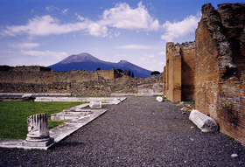

Slide 7
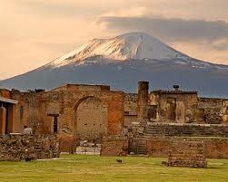
Effects Of Vesuvius
The city was not only destroyed, but "lost" for centuries. Forgotten over time, it wasn't until the 18th century when digging hit on some of its treasures that people realized it was still there, buried. Ironically, its destruction has given it a certain immortality. Because the events that overwhelmed the city happened so quickly, Pompeii has provided us with an unparalleled glimpse into the everyday life of the Romans of that time.

Slide 8
Effects of Vesuvius
At the time of the eruption, the town may have had some 20,000 inhabitants, and was located in an area in which Romans had their holiday villas. Prof. William Abbott explains, "At the time of the eruption, Pompeii had reached its high point in society as many Romans frequently visited Pompeii on vacations."
It is the only ancient town of which the whole topographic structure is known precisely as it was, with no later modifications or additions. Due to the difficult terrain it was not distributed on a regular plan as most Roman towns but its streets are straight and laid out in a grid in the Roman tradition; they are laid with polygonal stones, and have houses and shops on both sides of the street. It followed its decumanus and its cardo, centered on the forum.
Notes:
At the time of the eruption, the town may have had some 20,000 inhabitants, and was located in an area in which Romans had their holiday villas. Prof. William Abbott explains, "At the time of the eruption, Pompeii had reached its high point in society as many Romans frequently visited Pompeii on vacations." It is the only ancient town of which the whole topographic structure is known precisely as it was, with no later modifications or additions. Due to the difficult terrain it was not distributed on a regular plan as most Roman towns but its streets are straight and laid out in a grid in the Roman tradition; they are laid with polygonal stones, and have houses and shops on both sides of the street. It followed its decumanus and its cardo, centered on the forum. At the time of the eruption, the town may have had some 20,000 inhabitants, and was located in an area in which Romans had their holiday villas. Prof. William Abbott explains, "At the time of the eruption, Pompeii had reached its high point in society as many Romans frequently visited Pompeii on vacations." It is the only ancient town of which the whole topographic structure is known precisely as it was, with no later modifications or additions. Due to the difficult terrain it was not distributed on a regular plan as most Roman towns but its streets are straight and laid out in a grid in the Roman tradition; they are laid with polygonal stones, and have houses and shops on both sides of the street. It followed its decumanus and its cardo, centered on the forum. At the time of the eruption, the town may have had some 20,000 inhabitants, and was located in an area in which Romans had their holiday villas. Prof. William Abbott explains, "At the time of the eruption, Pompeii had reached its high point in society as many Romans frequently visited Pompeii on vacations." It is the only ancient town of which the whole topographic structure is known precisely as it was, with no later modifications or additions. Due to the difficult terrain it was not distributed on a regular plan as most Roman towns but its streets are straight and laid out in a grid in the Roman tradition; they are laid with polygonal stones, and have houses and shops on both sides of the street. It followed its decumanus and its cardo, centered on the forum.

Slide 9
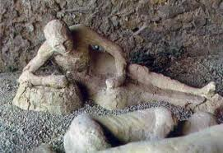
Bodies of Pompeii casted in ash

Slide 10
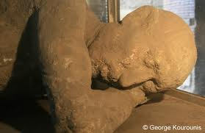
Bodies casted in ash

Slide 11
Eruption of Vesuvius
Historians say that Mount Vesuvius may have blown up on August 24th of the year 79. The Vesuvius eruption blew the top of the mountain completely off, spewing tons of ash, rocks, and lava 20 miles into the air. It buried not only Pompeii, but some of the smaller towns in the area as well. No one is quite sure how many people died in the attack, but the total is estimated to be more than 4,000.

Slide 12
Population
Historians believe the eruption happened in the year 79. At that time, Pompeii was a busy city of about 20,000 people. There had been earthquakes in Pompeii before, and there were probably rumblings and smoke coming from Vesuvius from time to time before the eruption.
Population was cut from 20,000 to 15,000 in the space of one day.

Slide 13
Rediscovery of Pompeii
After thick layers of ash covered the two towns, they were abandoned and eventually their names and locations were forgotten. The first time any part of them was unearthed was in 1599, when the digging of an underground channel to divert the river Sarno ran into ancient walls covered with paintings and inscriptions.
The architect Domenico Fontana was called in and he unearthed a few more frescoes but then covered them over again, and nothing more came of the discovery. A wall inscription had mentioned a decurio Pompeii ("the town councillor of Pompeii") but that it indicated the name of an ancient Roman city hitherto unknown was missed.

Slide 14
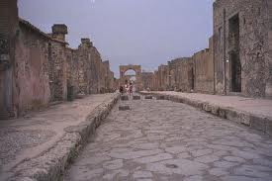
Rediscovery of Pompeii

Slide 15
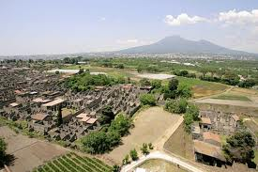
Pompeii today

