Slide 1
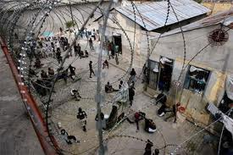
Haiti prison break
The prison

Slide 2
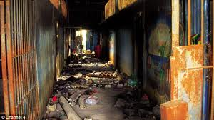
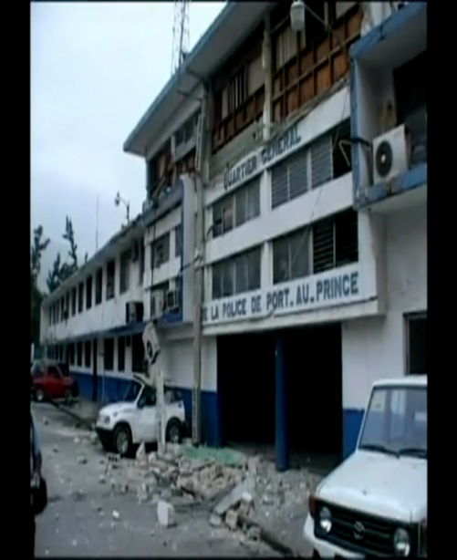
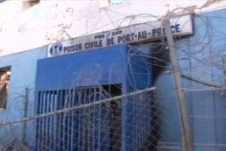
Prison after earthquake
horror and devastation of the massive 7.0 earthquake that has rocked Haiti, almost all of the 4,000 inmates in the capital's main prison have escaped thanks to the courtesy of the earthquake.

Slide 3
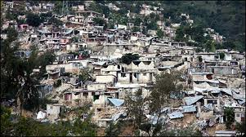
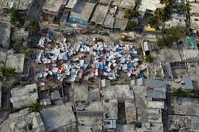
The prisoners home
The police force of Haiti knew where the prisoners would be heading: Cité Soleil, the poorest area of this poorest city, in whose maze of streets they could vanish like ghosts.

Slide 4
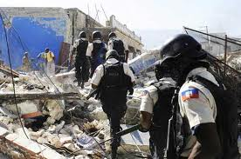
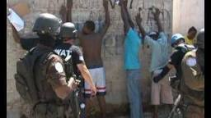
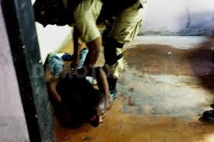
What is the police force doing?
The police force of Haiti is trying to capture the prisoners of the Port-au-Prince jail searching the mazes house by house trying to make cité soleil a safer place for the innocent people of Haiti.

Slide 5
Crime rate after earthquake
PORT-AU-PRINCE, Haiti has seen a dramatic increase in violent crime in the shanties of its major cities over the past six months, helping undermine faith in the country's police force, according to a study released .
Homicides in the heavily populated areas of Haiti's biggest cities appear to have increased sharply from August 2011 to last February, according to the study authored by social scientists Athena Kolbe and Robert Muggah, and backed by the Canadian government
Haiti's capital saw 60.9 murders per 100,000 residents over the year leading up to February 2012, the highest recorded murder rate since 2006,

Slide 6
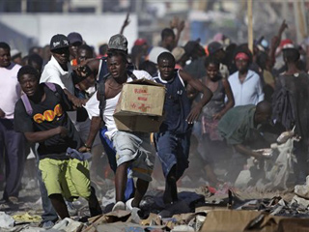

Slide 7
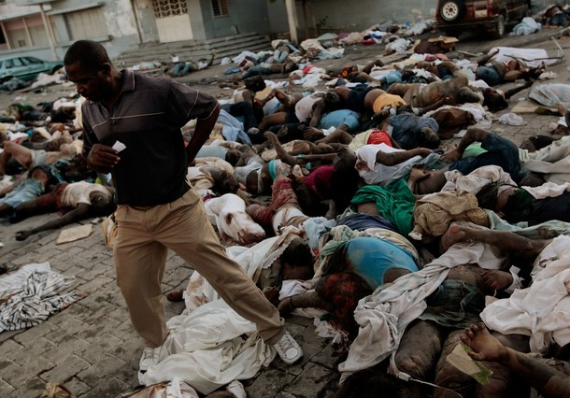
Death rate in Haiti
The death rate in Haiti is 8.1 deaths/1,000 population

Slide 8
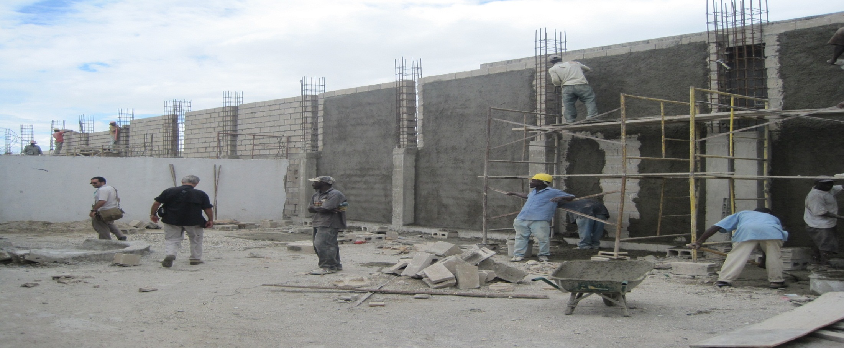
The prison now
The prison has been rebuilt but it took almost six months after the earthquake to rebuild it. That means that all the prisoners where free and dangerous for a long time! and still are today.

