Slide 1
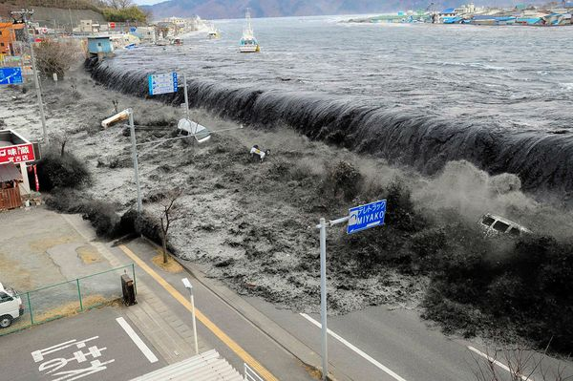
Tsunami In Japan 2011
By Paulina and Alexandra ☺

Slide 2
What is a tsunami ?
A tsunami is a series of waves, made in an ocean or other body of water by an earthquake, landscape.
Tsunami can cause huge destruction when they hit coastline.
Tsunami waves are different from the waves you can usually find rolling into the coast of a lake or ocean.
A tsunami wave in the open ocean can be more than 100km across.

Slide 3
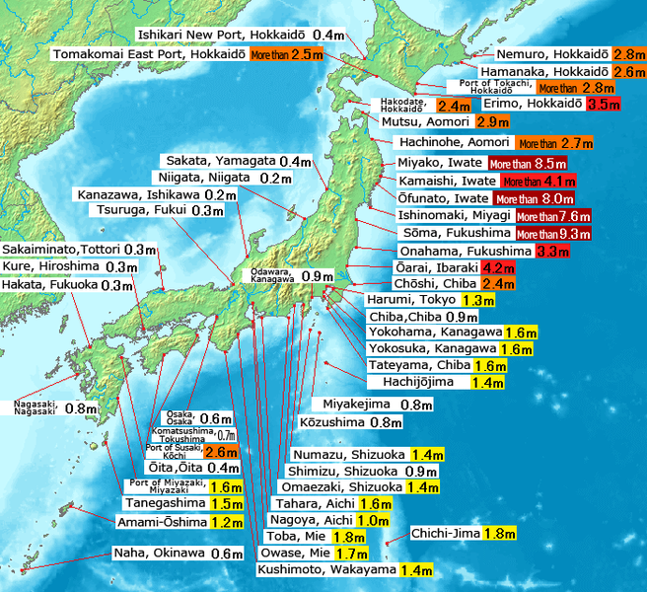
Facts about the Tsunami …
On March Friday the 11th ,2011 at 14.46 in the North Western Pacific ocean an earthquake hit Japan by a 9.0 magnitude.
The Tsunami caused a number of nuclear accidents, primarily the level 7 meltdowns at three reactors.
There was over eight hundred aftershocks of magnitude 4.5 Mw.

Slide 4
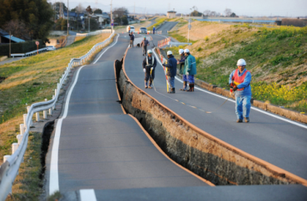
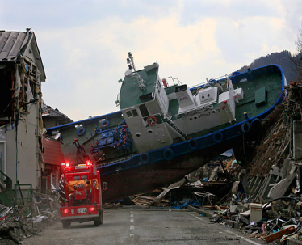
Damage and Effects
The degree and extent of damage caused by the earthquake and resulting tsunami were enormous, with most of the damage been caused by the tsunami.
Japans National Police Agency said on 3 April 2011, that 45,700 buildings were destroyed and 144,300 were damaged by the quake and tsunami .
300 hospitals with 20 beds in or more in Tohoku were damaged by the disaster, with 11 being completely destroyed

Slide 5
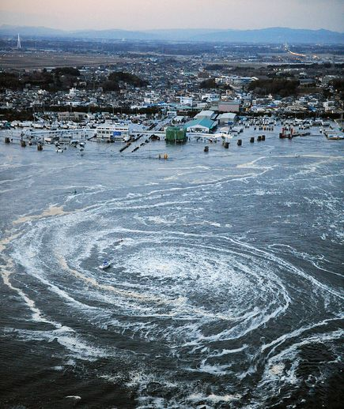
Tsunami in Japan also affected other countries such as Russia, Hawaii and South America
How Shifting Plates Caused the Earthquake and Tsunami in Japan.
the earthquake occurred where the pacific plate thrusts under the north American plate. Northern Japan sits on the west tip of the north American plate.

Slide 6
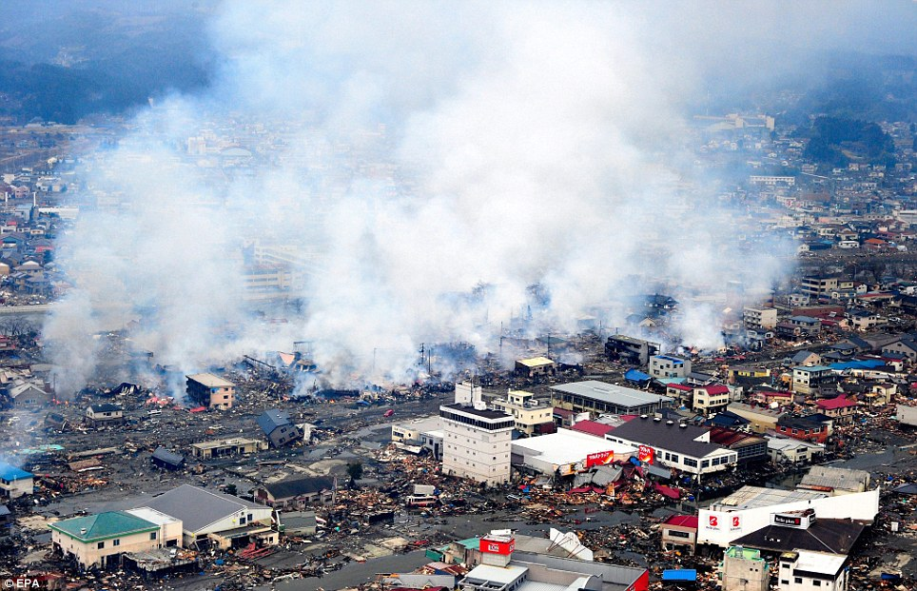
People that survived the tsunami
This unofficial emergency centre shelter was very low on supplies for the 350 people who were there.
3 hour line formed to fill everybody’s empty soda bottles from the 300 litter and 100 litter water containers .

Slide 7
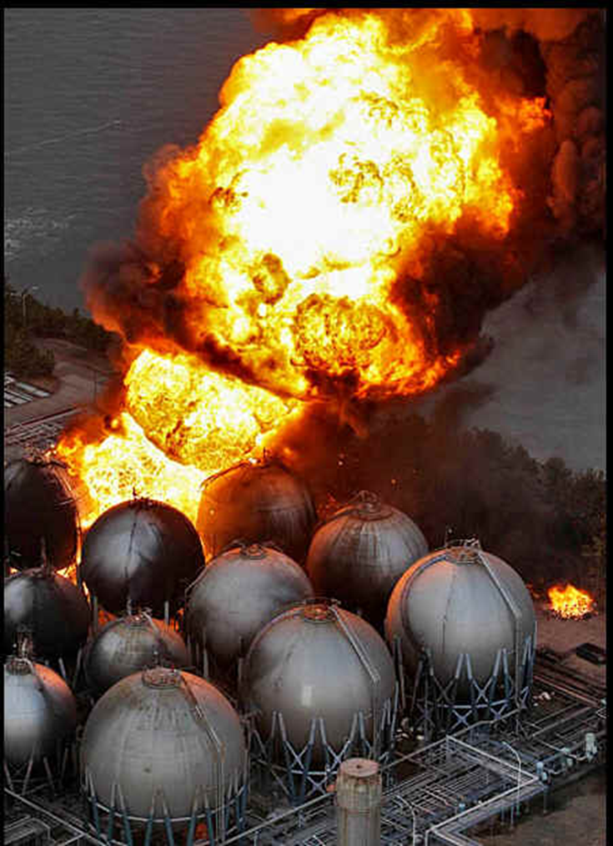
Fires after earthquakes are often caused by broken gas pipeline ..
CNN reported "The earthquake rattled buildings and toppled cars off bridges and into waters underneath. Waves of debris flowed like lava across farmland, pushing boats, houses and trailers toward highways.”
A number of fires broke out including one at an oil refinery which was burning out of control.
Giant fireballs rise from a burning oil refinery in Ichihara, Chiba Prefecture (state) after Japan was struck by a strong earthquake off its northeastern coast Friday, March 11, 2011.

Slide 8
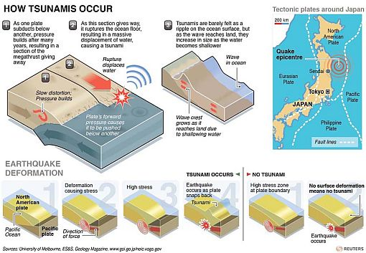
How do earthquakes cause tsunami?

Slide 9
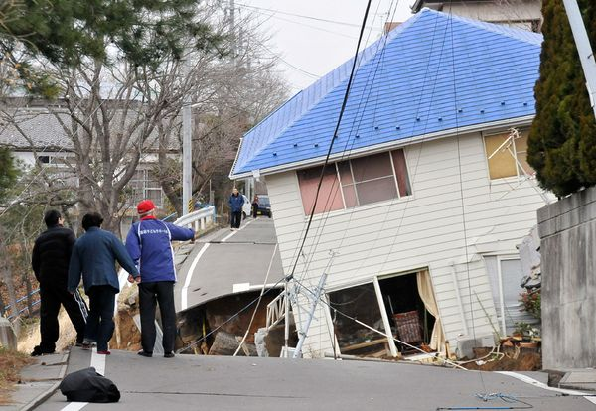
Homes and bridges effected by the tsunami …

Slide 10
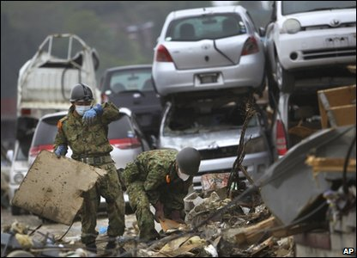
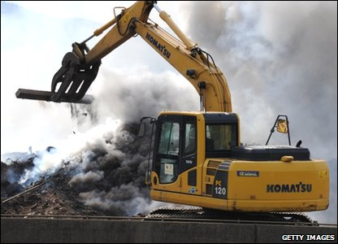
Helpers cleaning out rubble from the tsunami!

Slide 11
If you would like to take a look at what Japan looks like before and after take a look at this link >>> http://ww-quake-2011/beforeafter.htm
Also a very handy link to see as the tsunami hits the east coast of Japan >>> http://www.bbc.co.uk/news/world-asia-pacific-12725646
We would like to thank you for taking your time on watching this slide show and we hope you learn some new information about the Tsunami in Japan.

