Slide 1
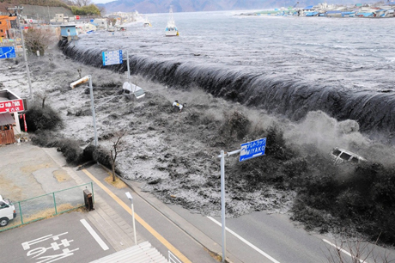
2011
Tōhoku
Tsunami

Slide 2
On 11 March 2011 at 15:55 JST a tsunami of at least 3 m (9.8 ft.) high hit Japan!

Slide 3
The tsunami warning issued by the Japan Meteorological Agency was the most serious on its warning scale; it rated as a "major tsunami", being at least 3 m (9.8 ft.) high. The actual height prediction varied, the greatest being for Miyagi at 6 m (20 ft.) high. The tsunami inundated a total area of approximately 561 km² (217 sq. mi) in Japan.

Slide 4
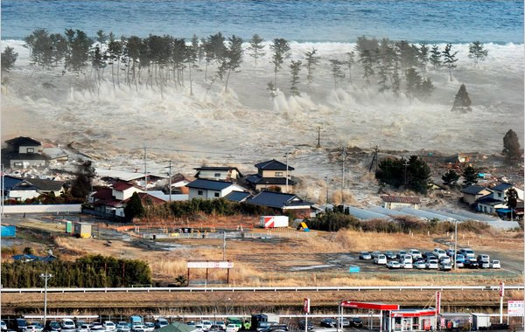

Slide 5
There were reports of entire towns destroyed from tsunami-hit areas in Japan

Slide 6
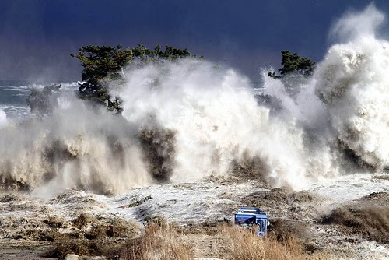

Slide 7
SENDAI AIRPORT!
The airport was first damaged by the 2011 Tōhoku earthquake and then badly flooded by the subsequent tsunami.
The floodwaters reached up to parts of the 2nd level of the passenger terminal, rendering electrical equipment, transformers and safety equipment inoperable.

Slide 8
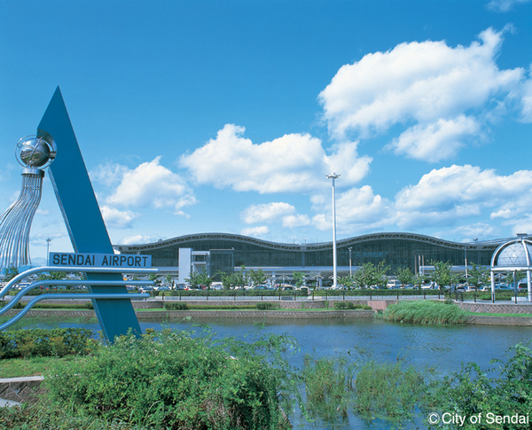
BEFORE

Slide 9
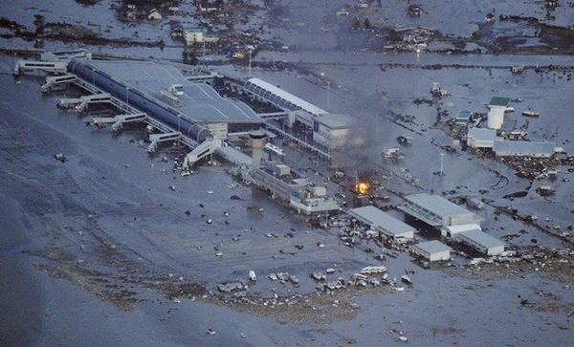
AFTER

Slide 10
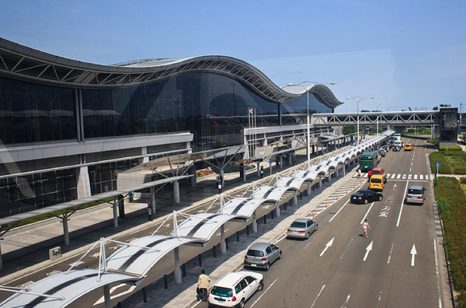
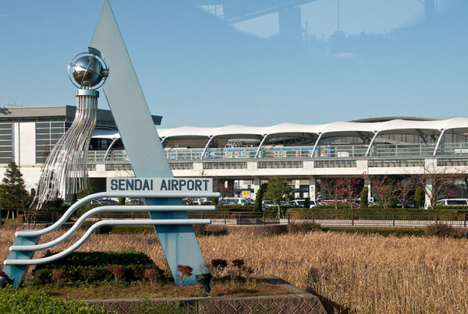
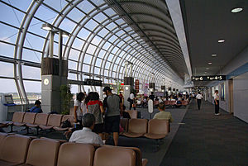
BEFORE

Slide 11
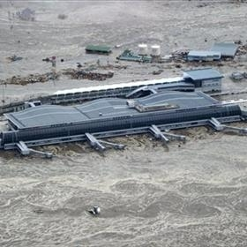
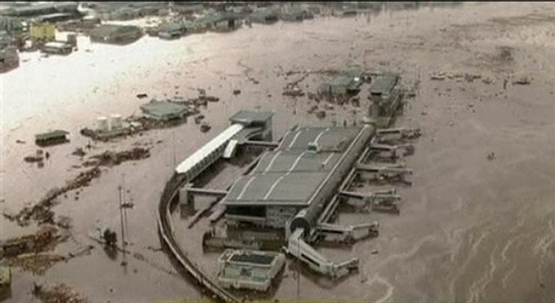
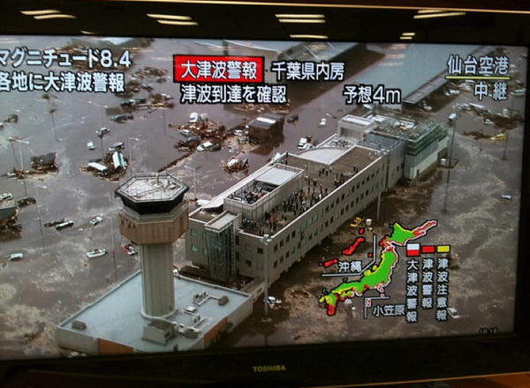
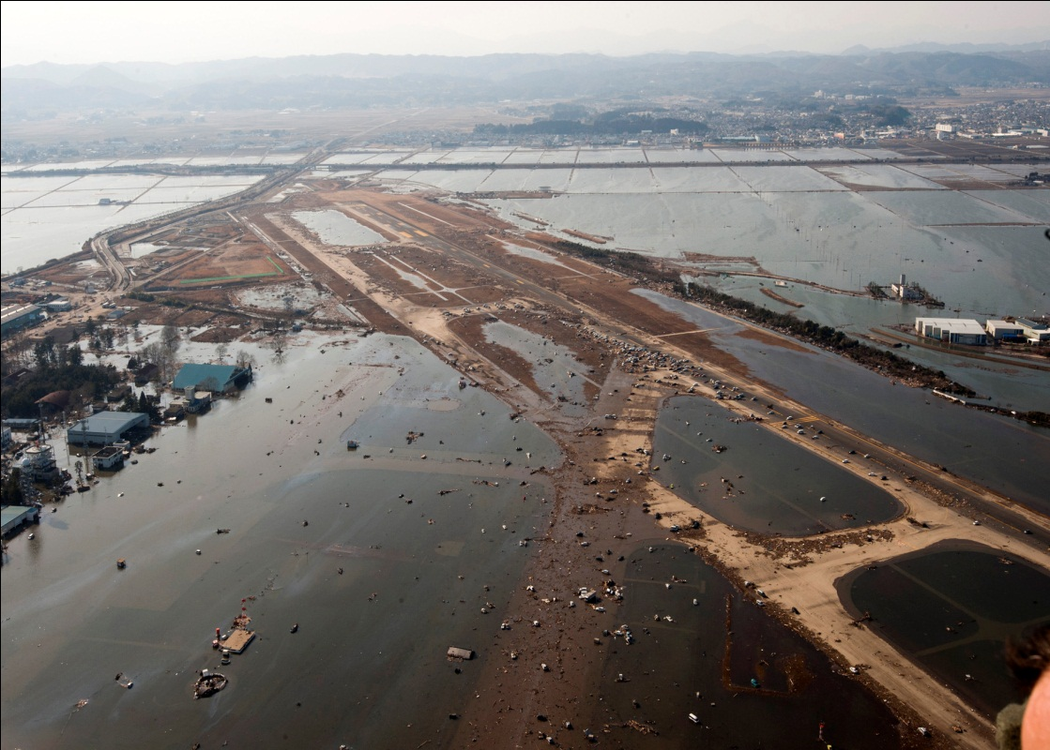
AFTER

Slide 12
19 months after tsunami, search for bodies begin in part of Tohoku
In part of north-eastern Japan’s Tohoku region, after 19 months of removing seawater and building protective ditches, the search for the bodies of those still missing began.
Nearly 16,000 people are confirmed to have died in the tragic March 11th, 2011 tsunami, but some 2,800 are still listed as missing.

Slide 13
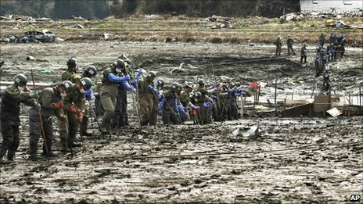

Slide 14
THE END!
Leah Meade!

